Slide 1

Presenters: Siddarth Reddy – 2845810
Pramodh Bakkera – 2834840
Ram prasad Gummadi - 2873418
Food Review
https://www.techquintal.com/advantages-and-disadvantages-of-multiprocessor-system/

Slide 2
Overview of Food Review
It is meant to delineate the features of the new application such as register, Login Page and Food review page which help the to know the food review and health benefits for the category-based products based on the Ingredients, for this users needs to register themselves and login into the application with the details. This software will help the to know the food review and health benefits for the category-based products based on the Ingredients and scope of the project is Users can register themselves by using register us link in the login page , so that they can view the food review based on products list and ingredients once user login into the application.
Login Page --- User can login into the application
Register Page---User need to register themselves to view the food review and comments
Food Review--- To view the food review either Good or Bad based on Product and Ingredients
Login Page
Register Page
Food Review Page

Slide 3
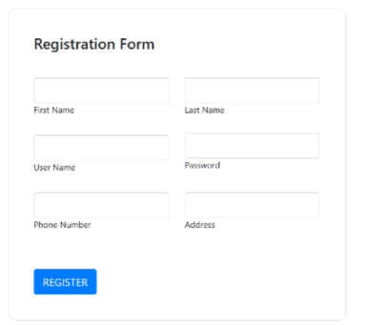
Food Review- Register Page
This helps the user to register themselves for accessing the application
The Below fig shows the Register page :

Slide 4
Food Review- Register Page Steps
After running the application in the net beans
1.Click on Sign Up Button in the page
2.Registration Form will be displayed
3.Enter the First Name
4.Enter the Last Name
5.Enter the UserName
6.Enter the Password
7.Enter the Phone Number
8.Enter the Address
9.Click on Register Button

Slide 5
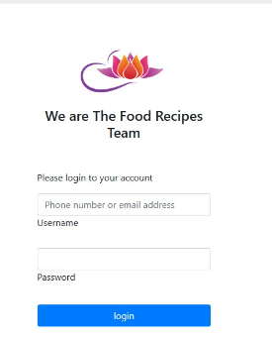
Food Review- Login
This helps the user to login into the application
The Below fig shows the Login Page

Slide 6
Food Review- Login Page Steps
After running the application in the net beans
1. Click on Login Button in the page
2. Login Page will be displayed
3.Enter the Username
4.Enter the Password
5.Click on Login Button
Note : Username and password should be get from the register page itself

Slide 7
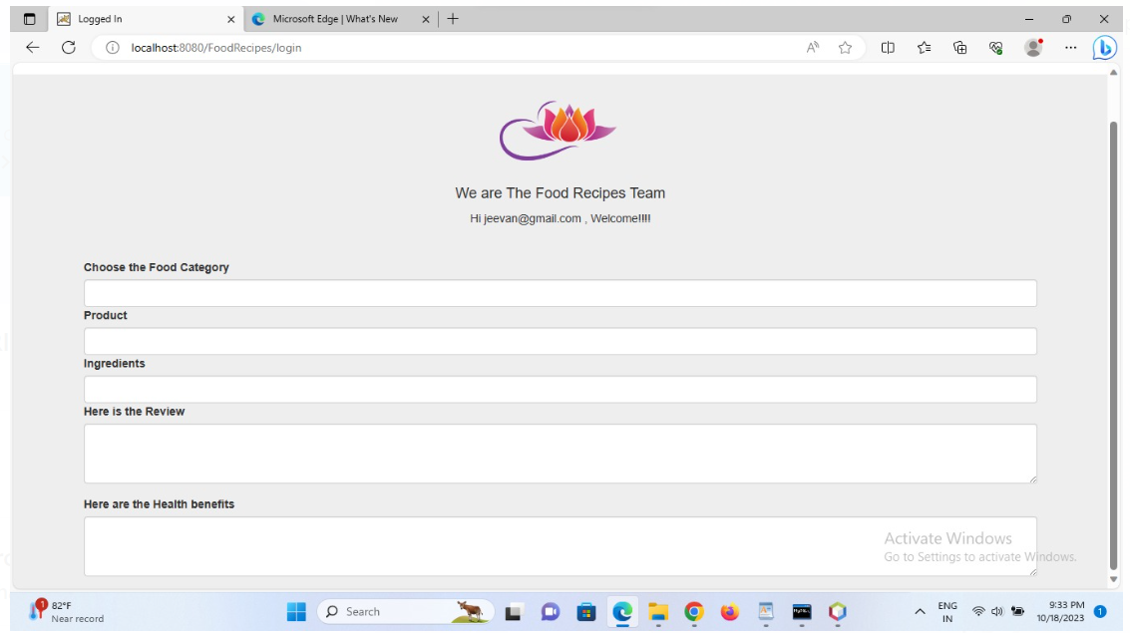
Food Review- Food Review Page
This helps the user to review the food based on the category
The Below fig shows the Programs page :

Slide 8
Food Review- Food Review Page Steps
After running the application in the net beans
1. Click on Login Button in the page
2. Login Page will be displayed
3.Enter the Username
4.Enter the Password
5.Click on Login Button
6.Now the Food review page will be displayed
7.Select the Food Category
8.Select the Product related to Food Category
9.Select the Ingredients related to Product
10.Now User can the review and health benefits for the food
Note : Username and password should be get from the register page itself

Slide 9
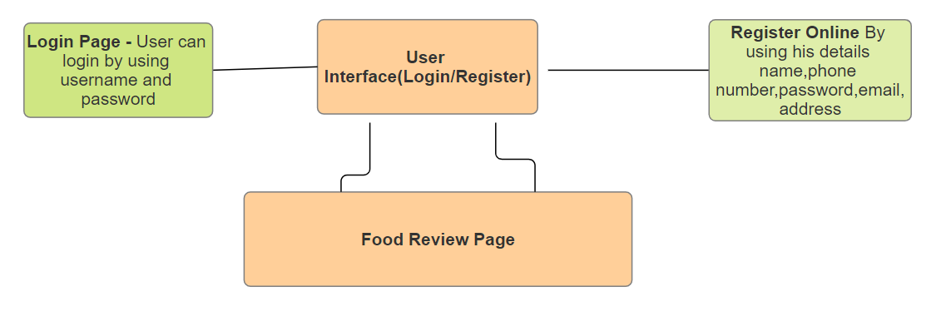
Food Review-Architecture Diagram
The Below Figure shows the architecture diagram of the food review and also components used as below:
Login: User must have their own valid credentials to access the system.
Register: User must provide basic required details to register into the system.
Food Review:User can select the category from the list and can view the comments and health conditions based on category

Slide 10
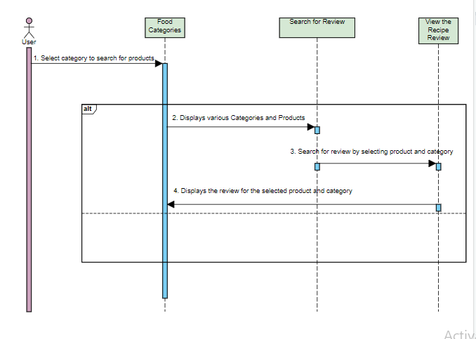
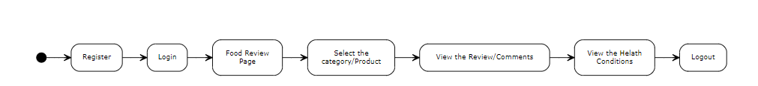
Food Review-Linear Sequence & Dyanmic diagram
The below show the linear sequence diagram for the Food Review Application
The below show the dyanmic diagram for the Food Review Application

Slide 11
Food Review-Techniques used for test case generation
Techniques used for test case generation
Equivalence Partitioning:
Divides input data into equivalence classes to reduce the number of test cases while ensuring adequate coverage. It tests one representative from each partition.
Boundary Value Analysis:
Focuses on testing boundaries of input ranges. Test cases are designed at the edges of input domains (minimum, maximum, and just inside/outside boundaries) to uncover potential issues.
Use Case Testing:
Based on use cases or user scenarios, this technique generates test cases to validate the system's behavior from an end-user perspective.
Regression Testing Selection Techniques:
Selects test cases from an existing suite to ensure that changes in the software haven’t adversely affected previously tested functionalities.

Slide 12
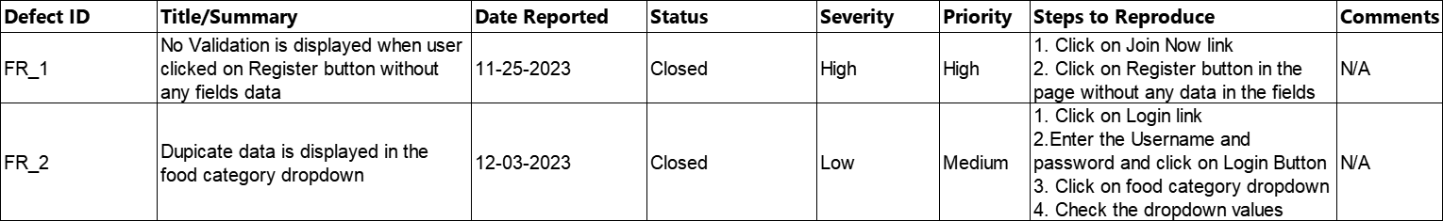
Food Review-Test results and assessments,Defect Report
Test Results Test Assessments
Feature Name | Test Results | No of Bugs Reported | Pending Bugs at final
Register Us | Pass | 1 | 0
Login Page | Pass | 0 | 0
Food Review Page | Pass | 1 | 0
Assessment Type | Definition | Value/Qty/Status
Defect Count | Measure the number of defects found in different phases of testing. | 2
Severity | Assess the impact and severity level of each identified defect. | Pass
User Feedback | Gather user feedback through surveys or direct interaction. | N/A
Usability Testing Results | Evaluate ease of use, user interfaces, and overall user experience | Pass
Regression Test Results | Assess if new changes introduced any regression issues by comparing against baseline results. | Pass
Security Testing Results | Analyze vulnerabilities and security breaches identified during testing. | Pass
Defect Report

Slide 13
Food Review- Conclusion
Food Review is a java web application with a local host url and its helps users to know the food review and food health benefits based on category and ingredeints selected.
Users can register themseleves directly to get the access into the application by using the register page and can go to the food review page to check the food review and food health benefits based on category and incregents selected.

